Slide 1

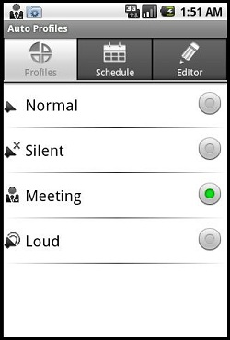
PROFILE SWAPPER
( For Android Mobiles)
Under the guidance of
Mr. Vikranth
Presented by:
Y.Shravani(11D21A0593)
P.Sirisha Rani(11D21A0595)
J. Tejaswi(11D21A05B5)

Slide 2
PROFILE SWAPPER
In real life, forgetting the things is a very common tendency by humans. Few times, we may keep the things in our premises and we may forget about it. Same thing may happen with our mobiles phones too. We may forget/lose our phone in our near premises. We may think that, we can just make call to that phone and find the location. Where in few cases you may want to set your phone mode to silent when you are at some work and your phone isn’t near you, but you still might want to turn it to silent. But if the phone is in silent mode what can we do to our mobile and how can we change its profile? In these situations, this project is very helpful. In this project, just by sending a single customized message to our phone we change our phone mode to ringing or silent or vibrate or flight profile.

Slide 3
INTRODUCTION :
The application focuses on the changing of the phone’s current profile to the desired profile.
The process goes with the sending of a customized text message to the concerned mobile. The message need to contain the code alone for this to happen.

Slide 4

PROFILE SWAPPER
You are in a state that you do not find your mobile.
Notes:
In day-to-day life, we may get engaged to many activities. Few works include with the mobile.
You might place your phone at some desk and you are at another place. You do not know where you have placed your mobile. And it is on silent!!!
You search every possible place but still you do not find it.
You feel like having an option that could trace your phone and change to ring mode..
You try for every alternate way but still left with no choice..

Slide 5

At Meeting
You kept your phone in your draw and it is in sound profile.
Gosh!!!! My phone is in normal mode in my desk!!!
Notes:
Another scenario is :
You are in an important meeting and left your mobile in your desk. You are worried that it might sound when some one rings, you want to put it on silent but you cant!
You cannot make a move to make it not sound as it is a meeting with your boss..!!

Slide 6


Here is the application that reaches your need..
Profile swapper is an application that changes the mode of the mobile to the desired mode.
Switching of Profile
ring
silent
Notes:
By setting the codes to the profiles of your mobile, it switches the profile to the required mode when ever you want.
This is done by sending the code alone in the text message from any other mobile.
The code that is set for the respective profile gets activated and turns the mobile to that profile.

Slide 7

The application goes this way
Before starting off with the application, there are few tings to be taken into point.
Notes:
Firstly the important points to be noted are,
the mobile should be of an android operating system.
The application must be installed in the mobile.
The mobile must be in “ on “state.
The mobile that sends the text message need not to be of android operating system.

Slide 8
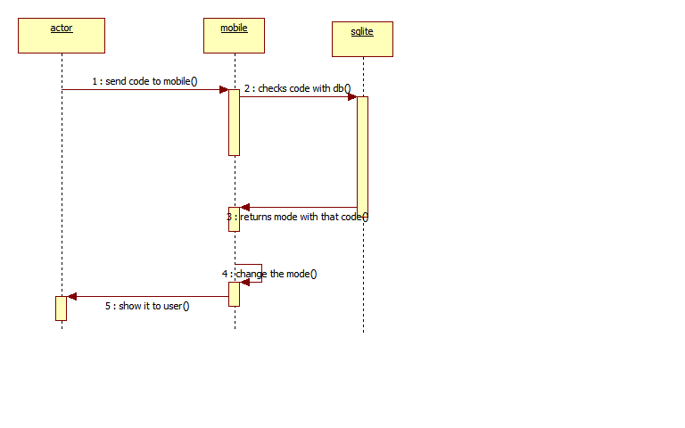
SEQUENCE DIAGRAM:

Slide 9
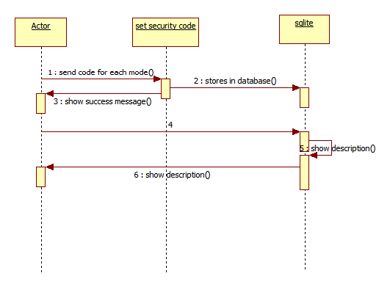
SEQUENCE DIAGRAM:

Slide 10
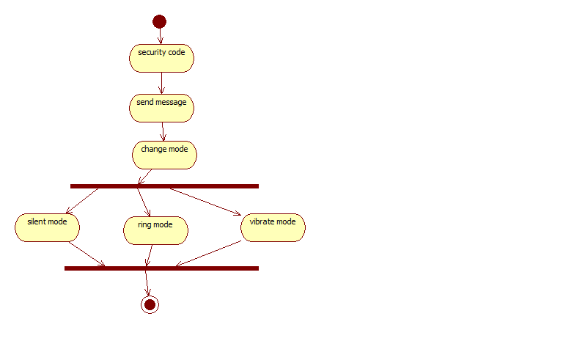
ACTIVITY DIAGRAM:

Slide 11
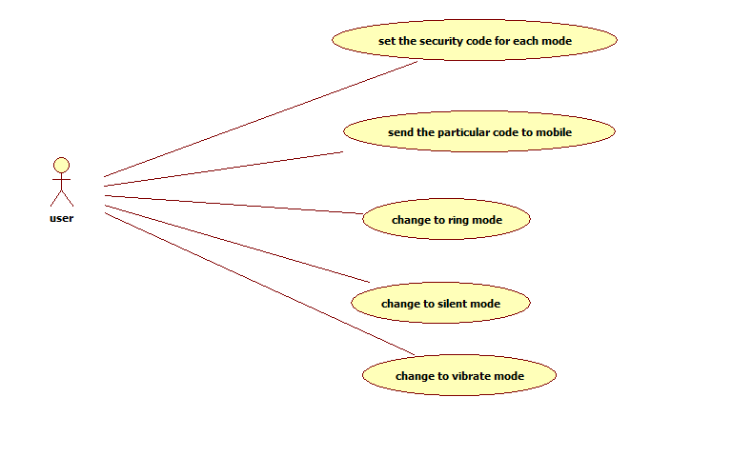
USECASE DIAGRAM:

Slide 12
CLASS DIAGRAM:

Slide 13
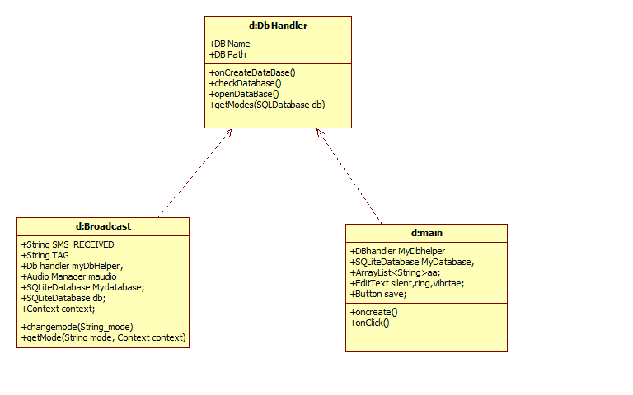
OBJECT DIAGRAM:

Slide 14
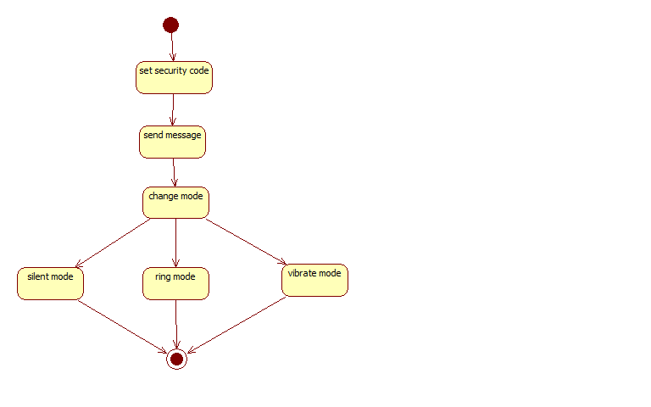
STATECHART DIAGRAM:

Slide 15
DEPLOYMENT DIAGRAM:

Slide 16
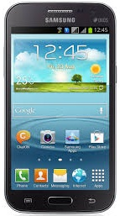

ABOUT THE APPLICATION :
SIGN UP :
First and fore most step is u need to register to an account .
Sign in
Sign up
Notes:
The registration page contains the name, password, and a phone number fields.
The user will have to fill in the required fields and sign in.
The registration is essential as it secures the account from others who access your application.
Once you are logged into your account, you will not be asked for a sign in option over and over.

Slide 17
SIGN UP PAGE :
The user is allowed to sign up for the application before he can use the application.
Login name
Password
Confirm password
Sign up

Slide 18
SIGN IN:
Sign in to the application
***
Login name
Password
Sign in
Notes:
Setting a passcode for the application secures the application for unauthorized access.
The application does not allow the user to access unless he/she cracks the code.

Slide 19
START APP :
This screen gives you a brief description about the application.
Hi!
Welcome to the application. This application lets you set codes of the profile in your mobile and can change the profile when ever you send respective profile
Start app

Slide 20
SET CODES :
The screen lets you set codes for the respective profile .
Set codes
Profiles
Codes
Normal
573
Silent
5677
Vibrate
9906
Flight
76576
Store keys
Save

Slide 21
STORE KEYS :
The store keys button is an email facility option. It sends the codes to the respective mail.
Subject
compose
From
bc@gmail.com
To
Normal 573
Silent 5677
Vibrate 9906
Flight 76576

Slide 22
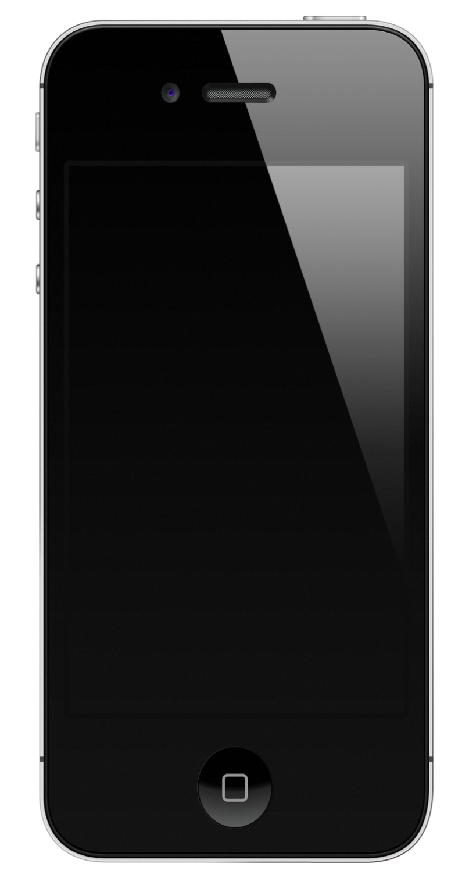



WORKING :
Your mobile is in silent mode for instance.
You want to change it to vibrate.
Notes:
On the main screen, it is clearly visible that the mobile mode is in silent.
Now to change the profile of the mobile, the user needs to send an s.m.s to his concerned mobile.

Slide 23
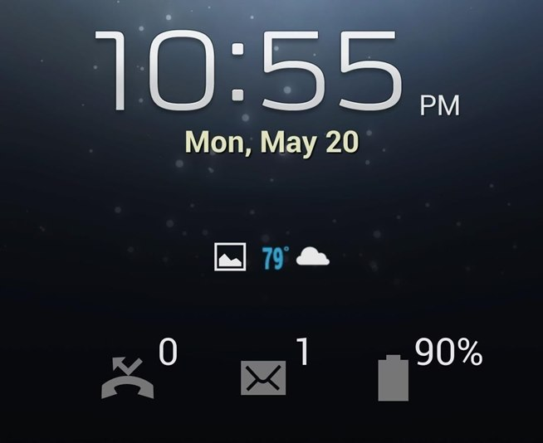
The text message containing code (for vibrate) alone is sent by the user to his respective mobile.
Now, the mode changes to vibrate.
Notes:
The text message sent can be from a non-android mobile or a android or from a server (ex: way2sms,ultoo,160by2,etc).
The message do not need to be read. As soon as the message is received the profile changes equivalent code.

Slide 24
v
Profile is now in vibrate.
Hence, task successful
Notes:
As soon as the message is received, the profile is now changed.

Slide 25

9949977006
9906
Hi..
What the text message contained is the code of the vibrate.
Notes:
Now is the situation where you have to turn on your mobile to sound or to turn off the sound.
All you have to do is send a “ Text message “ to your mobile.
The text message need not to be only from an android operating system mobile. It can be from any mobile.
The text message should contain only code of the respective profile and nothing else.
When the concerned mobiles receives the text message that contains the code, the mobile profile changes to the specified profile.
Hence, the task is successful !!!

Slide 26

EXISTING SYSTEM :
There are few applications which only changes the mode of a mobile when lost in the silent state, to the ring state .
Notes:
The procedure goes same way, by sending the text message from other mobile to the concerned mobile.
The application allows the user to change from one state to other state by setting an alarm as the notification/alert to the user when the code of the ring mode is given.
The user can turn off the alert tone/alarm when he/she gets the phone back to him/her.
For few applications, there is a time limit for the alert tone when a code for ring mode is sent.

Slide 27

PROPOSED SYSTEM :
Changing of profile from one to another.
Setting a no time limit alarm.
Providing an e-mail facility.

Slide 28

HARDWARE REQUIREMENTS
Operating System : Pentium based systems with a minimum of p4
RAM : 1GB (minimum)
Hard Disk : 40GB or above

Slide 29

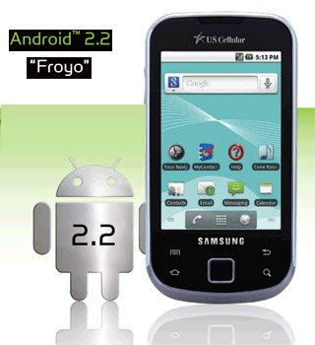

SOFTWARE RERQUIREMENTS
IDE: Eclipse
OS: Windows XP and above
SDK: Android 2.2 and above

Slide 30
MODULES
Setting the customized Codes.
Changing the phone mode.
UI Module.
Notes:
1. Setting the customized Code:
In this module, we need to set code for each mode i.e. silent, ring and vibrate and flight. By default, values will be silent for silent mode, ring for Ring mode, vibrate for vibrate mode and flight for flight mode. User can also change these values.
2. Changing the phone mode:
Whatever the codes you have given, just send that code as message to your phone. Then your phone will be changed to that particular mode what u have sent.
3. UI module :

Slide 31
CONCLUSION :
The application is useful when the users is in the need of his phone’s profile. The application reaches the users’ enough requirements that is all needed to make a change in the profiles.

Slide 32


Slide 33


